Slide 1
AWS CloudFront
Pradeep Raut

Slide 2




Slide 3
What is AWS CloudFront?
Amazon CloudFront is a web service that speeds up distribution of you static and dynamic web content, such as .html, .css, .js and image files, to your users.

Slide 4
Key Notations
Routing
Edge Locations
More Avaibility

Slide 5
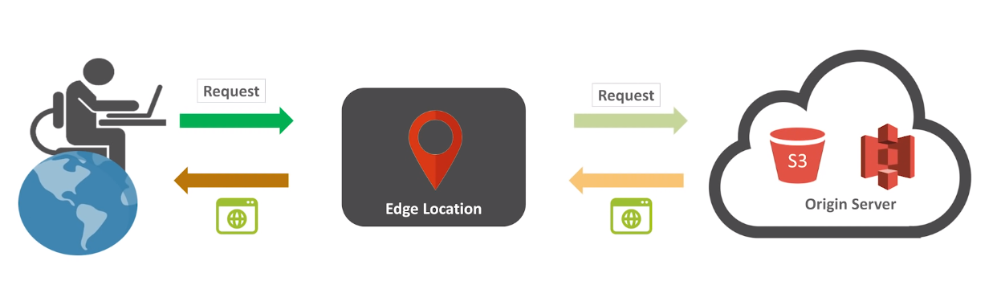
How AWS CloudFront Delivers Content?

Slide 6
Advantage
Accelerate Static Website Content Delivery
Serve On-Demand or live Streaming Video
Encrypt Specific Fields Throughout System Processing
Customize at the Edge
Serve Private Content by using Lambda@Edge Customizations

